Slide 1
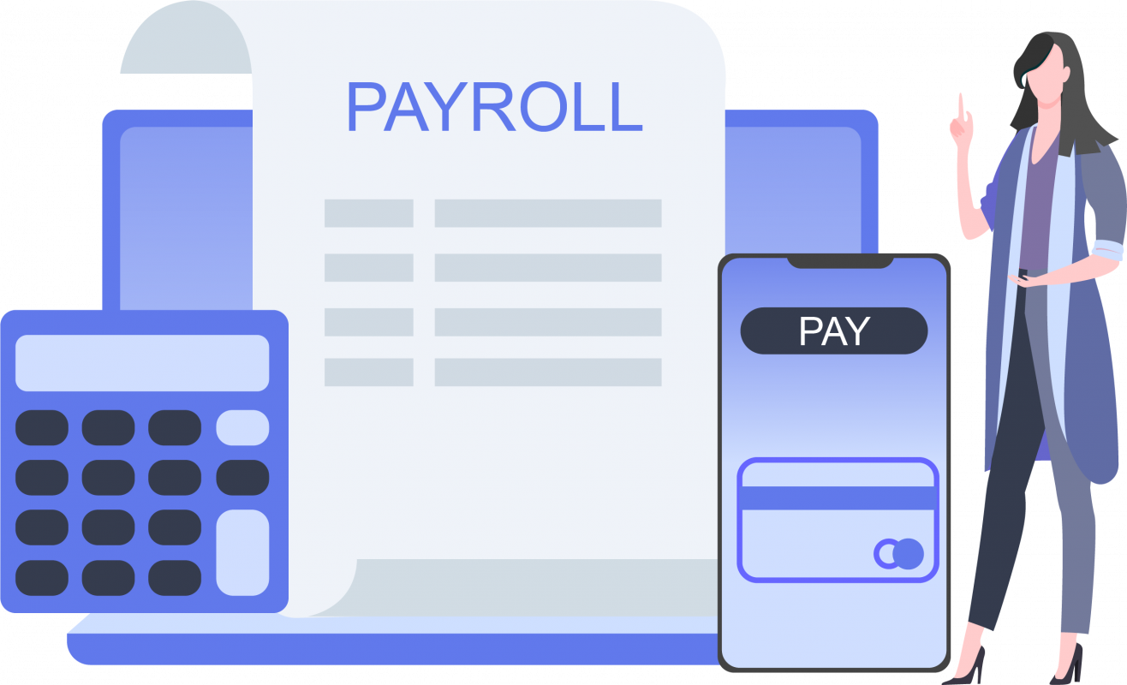
Employee Payroll Management System

Slide 2




Team Members
Varun Awasthi
varun.awasthi@globallogic.com
Syed Aziz
syed.aziz@globallogic.com
Shivani Raut
shivani.raut@globallogic.com
Shivani Chahar
shivani.chahar@globallogic.com

Slide 3
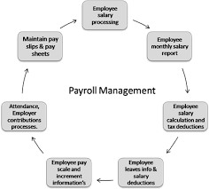
Introduction
Payroll Management System is basically used to built a application program, that a company uses to manage the records of the employees working in the company.
Only the administration(Finance Department) has the legal rights to work with the system. Employee can only log on to the system to see their current status.

Slide 4

Why Payroll System is used?
Create Records
Delete Records
Save Records
Modify Records
For employees according to their information given to administration of the company.

Slide 5

Project Objectives
To improve efficiency of the company’s administration.
To store up-to-date information of a employees.
To make the employees understand the rules of the company.
To reduce the extra cost for the security of the database.

Slide 6
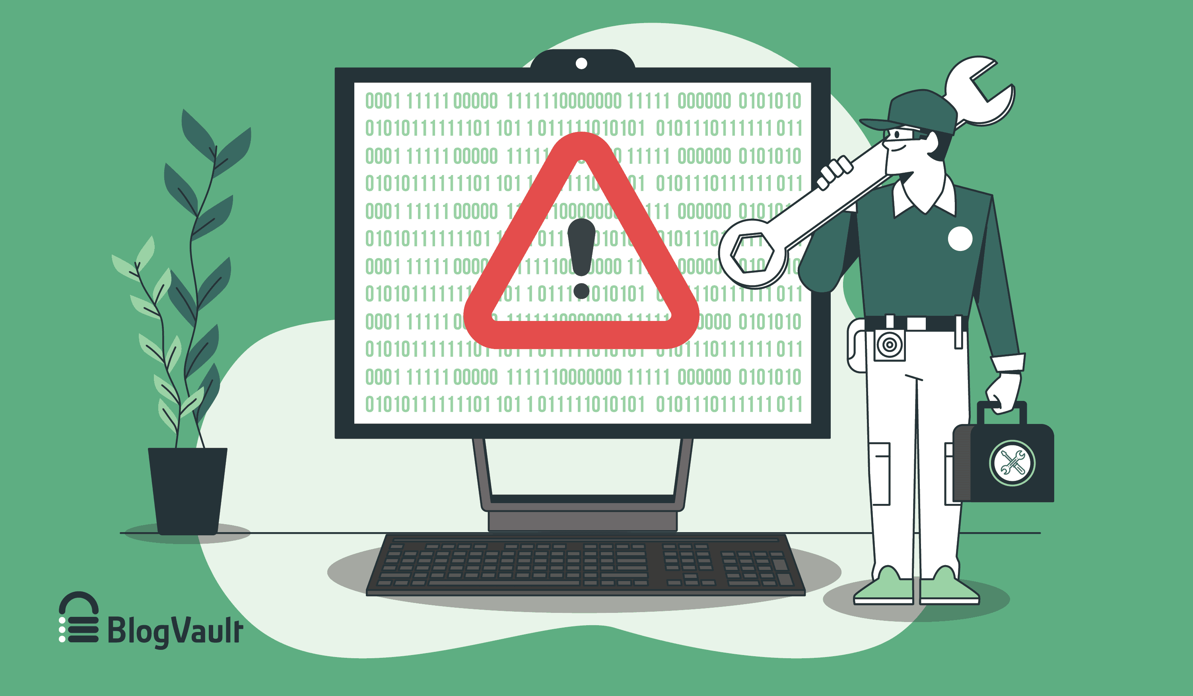
Technical Issues
How the program saves the data?
How errors are detected and how the error messages are to be displayed?
What happens when we try to overwrite the data?
Is the software user friendly?

Slide 7

Project Description
The term payroll emphasizes every employee who receives the regular wage or other compensation, how the payment method would be received by each employee according to their allowances and deductions and the appropriate pay slip are issued.
After payroll accountant calculate employee salary after all deductions and allowances, then net salary is entered into the program.
Setting up an effective payroll system is not difficult or trained professionals, but it can be very time consuming.

Slide 8
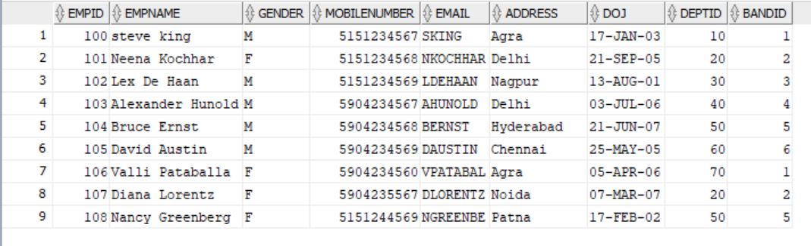
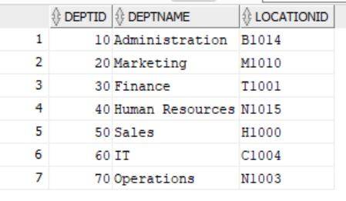
The Most Important Modules of the Design are:-
Employee
Employee Data
Department Data
Band Data
Location Data
Allowances Data
Deductions Data
Timesheet Data
Payroll Data
Bank Details
Login Data
Department

Slide 9
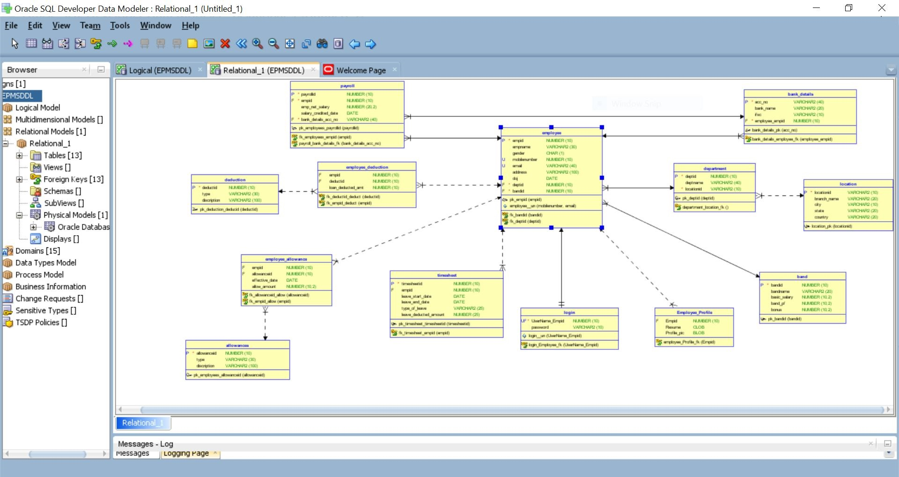
Data Model Diagram

Slide 10
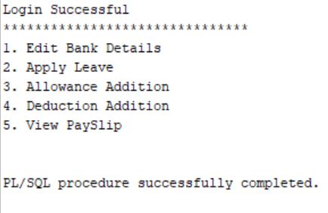
Stored Procedure
Employee Login
Employee can login into the system to manage their payroll details like they can apply leave or apply allowances etc.
Note:
If the employee is not from Finance Department then Edit Bank Details will not be permitted to him/her

Slide 11
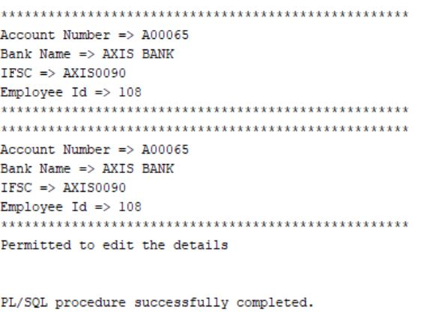
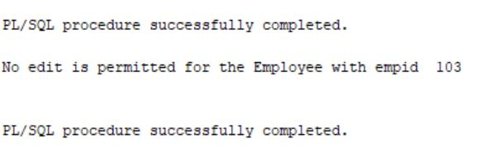
Stored Procedure
Employee In Finance Department
Edit Bank Details
This procedure puts the restriction on modifying the employee bank details and allow only Finance Department to update the details, i.e. it has the legal rights to work with the system.
Employee Not In Finance Department

Slide 12
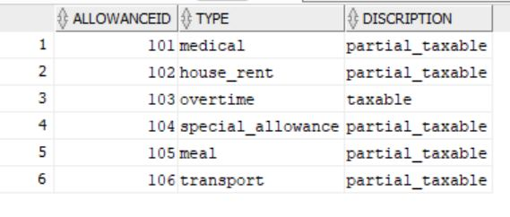
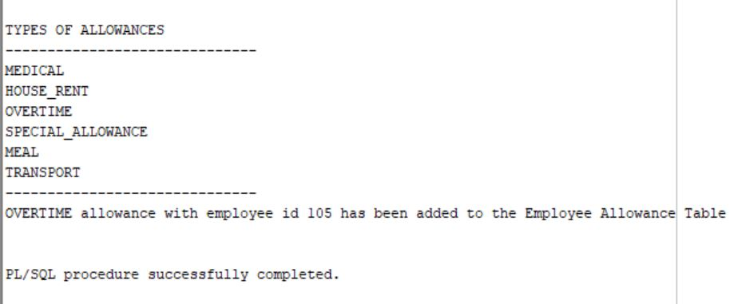
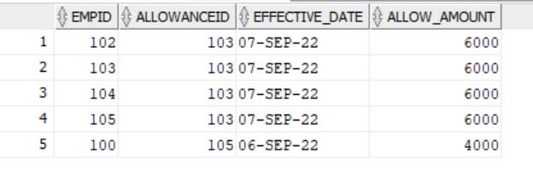
Stored Procedures
Allowance
Allowances Addition
Employees can apply different types of allowances according to their needs and requiements.
Employee Allowance

Slide 13
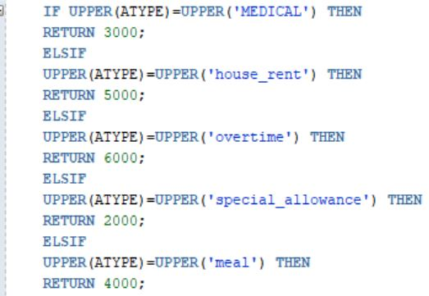
Function
ALLOWANCE AMOUNT
This function will calculate the allowance amount that will be added to the employee salary according to their allowance type.
We have allowance like Medical, HRA, Overtime, Special Allowance and Meal.
In this function,
Certain amount is substituted for every allowance like
Medical = Rs 3000 will be substituted and so on.

Slide 14
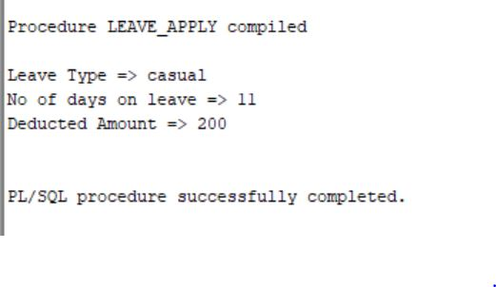
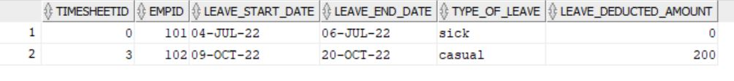
Stored Procedure
Apply Leave
Employee can apply for leaves into their TIMESHEET and depending upon the type of leave and number of days on leave, some amount will be deducted from their salary.
TIMESHEET

Slide 15
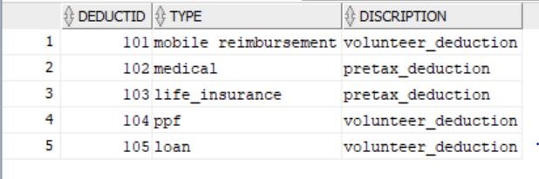
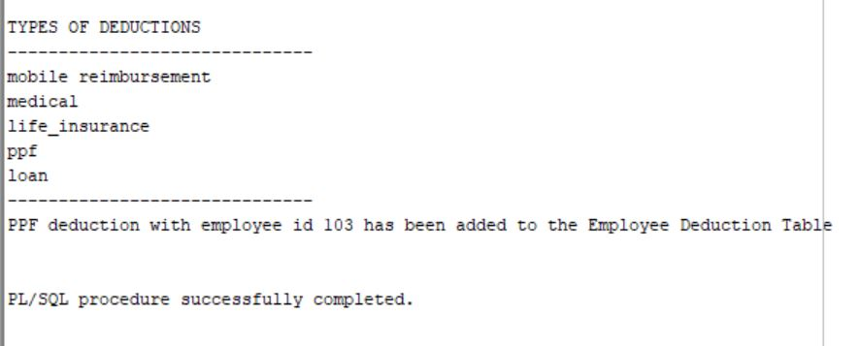
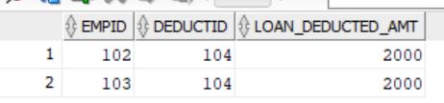
Stored Procedure
Deduction
Deduction Addition
Deduction will be reflected into employee salary according to their services they use.
Employee Deduction

Slide 16
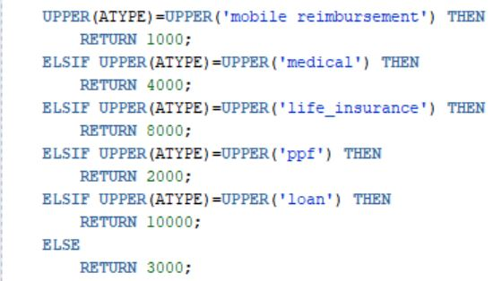
Function
DEDUCTION AMOUNT
This function will calculate the deduction amount that will be deducted from the employee salary according to their deduction type.
We have deductions like Mobile Reimbursement, Medical, Life Insurance, PPF, Loan etc..
In this function,
Certain amount is substituted for every allowance like
Medical = Rs 3000 will be substituted and so on.

Slide 17
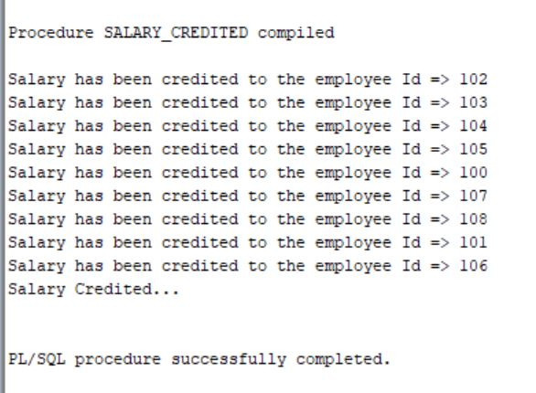
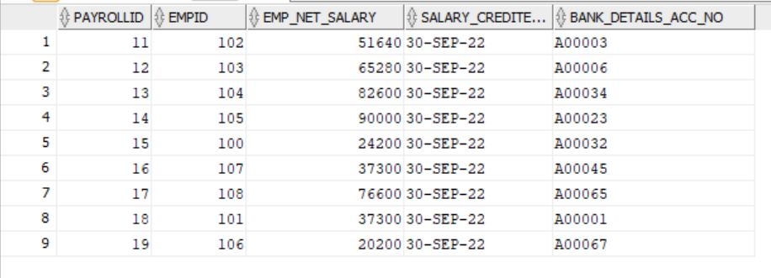
Stored Procedure
Salary Credited
On every 30th of the month salary will be credited in the bank account of each employee after calculating the net salary based on allowances and deductions.
Payroll

Slide 18
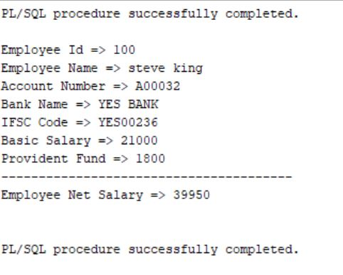
Stored Procedure
View Pay Slip
This procedure help in maintain the history of the employee pay slip and shows all the details about the salary like their PF deduction, bonus, basic salary and Net Salary.

Slide 19
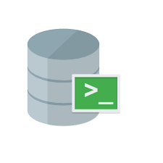


Software Requirements
Sql developer
Sql datamodeler
Sqlcl
LiquiBase
Jenkins
Git

Slide 20
Sql Data Modeler
Oracle SQL Developer Data Modeler (referred to as Data Modeler) is a straightforward data modeling and database design tool that comes with a user-friendly environment for capturing, managing and exploiting metadata. It provides a model driven approach for database design and generation and allows you to create various models including relational, logical and data flow diagrams.

Slide 21
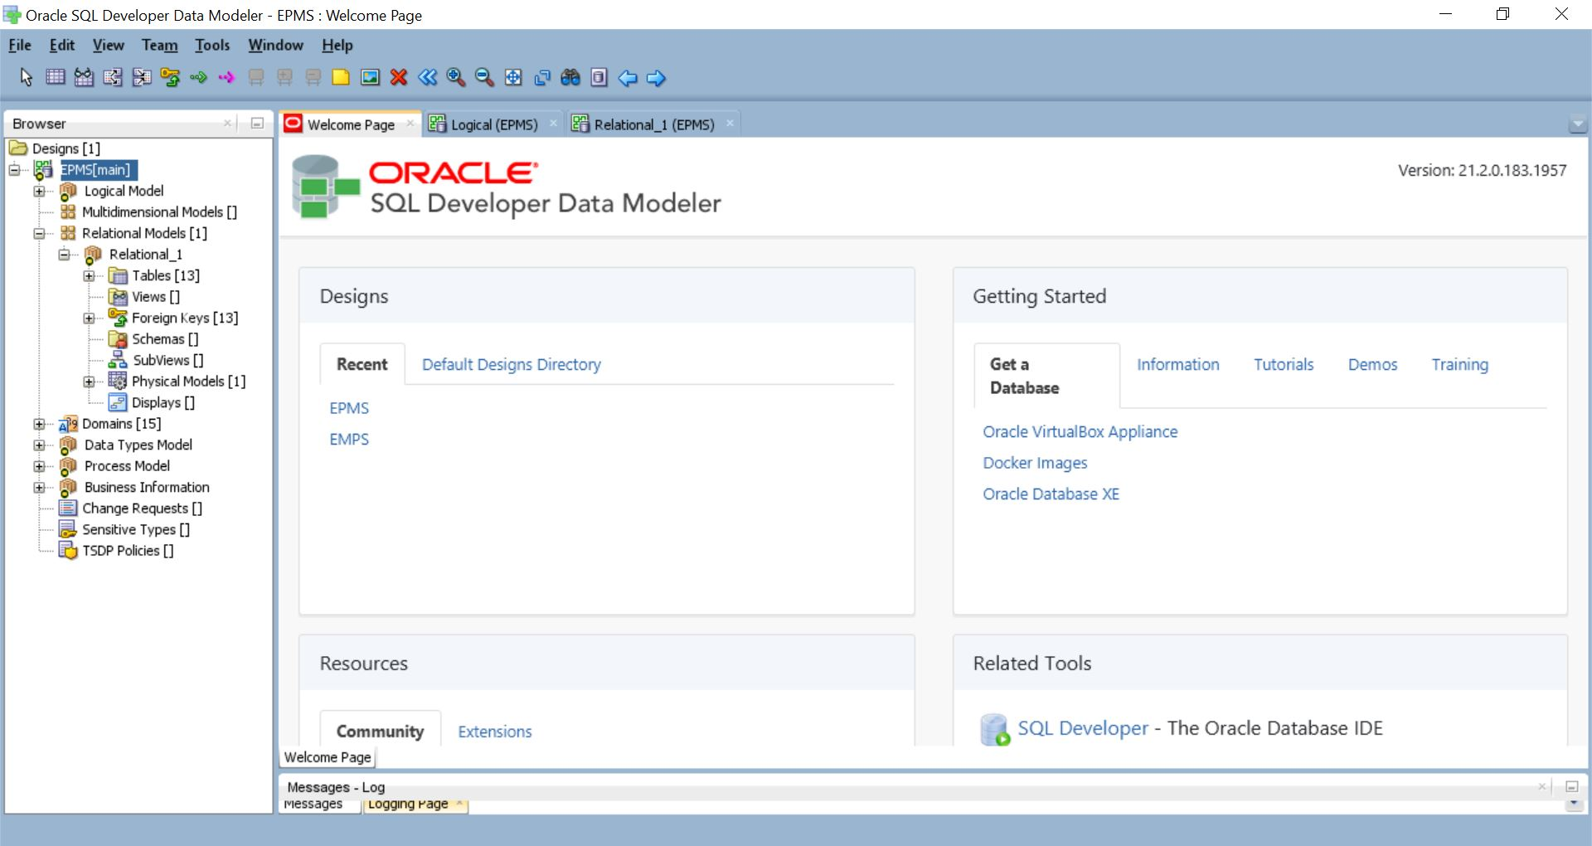

Slide 22
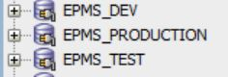
Sql Developer
Oracle SQL Developer is a free graphical tool that enhances productivity and simplifies database development tasks. Using SQL Developer, you can browse database objects, run SQL statements, edit and debug PL/SQL statements and run reports, whether provided or created.
The whole code is implemented using three environments
Developer, Testing, Production in the Sql Developer

Slide 23
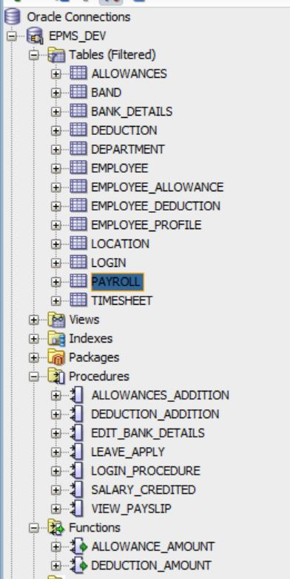
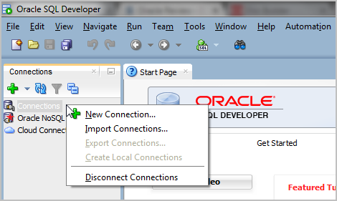
Developer Environment
A development environment is a collection of procedures and tools for developing, testing and debugging an application or program.

Slide 24
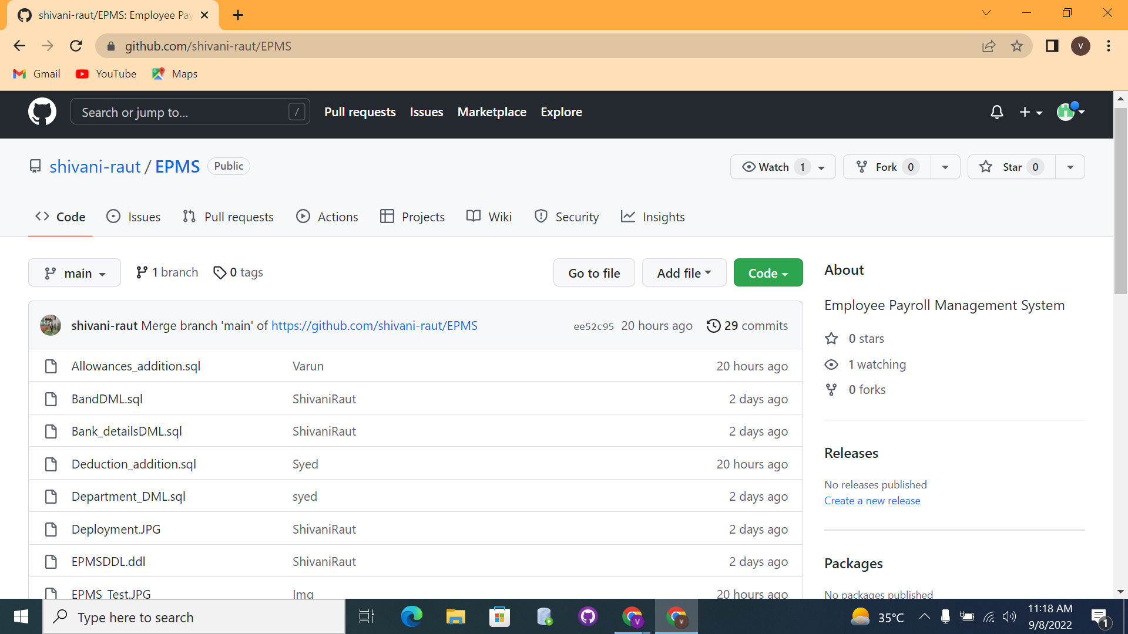
Integration through Git
Here we have one repository collaborated by every team member in which we integrate.
Every member push their work in to the repository and pull others work to implement further work on the project.

Slide 25
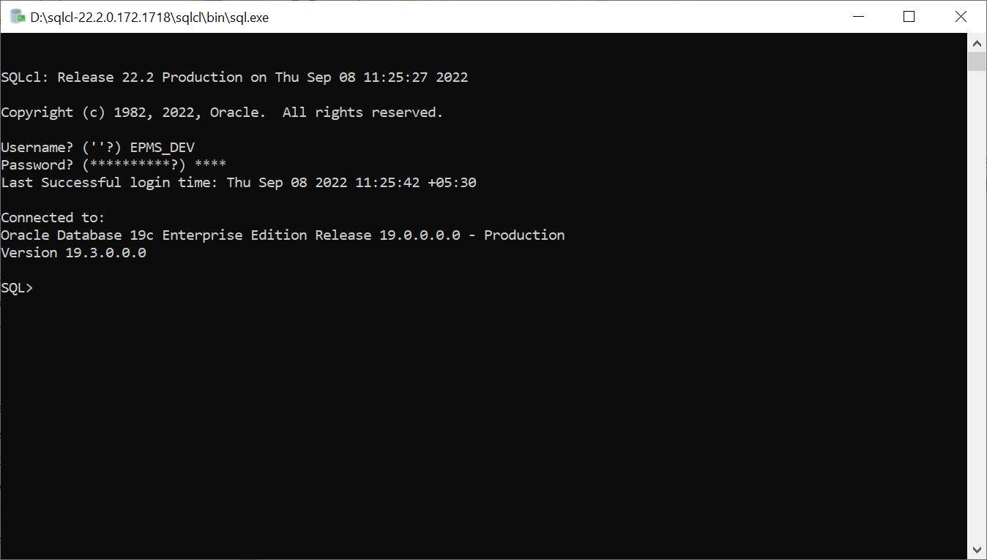
SqlCL
It allows you to interactively or batch execute SQL and PL/SQL. SQLcl provides in-line editing, statement completion, and command recall for a feature-rich experience, all while also supporting your previously written SQL*Plus scripts.

Slide 26
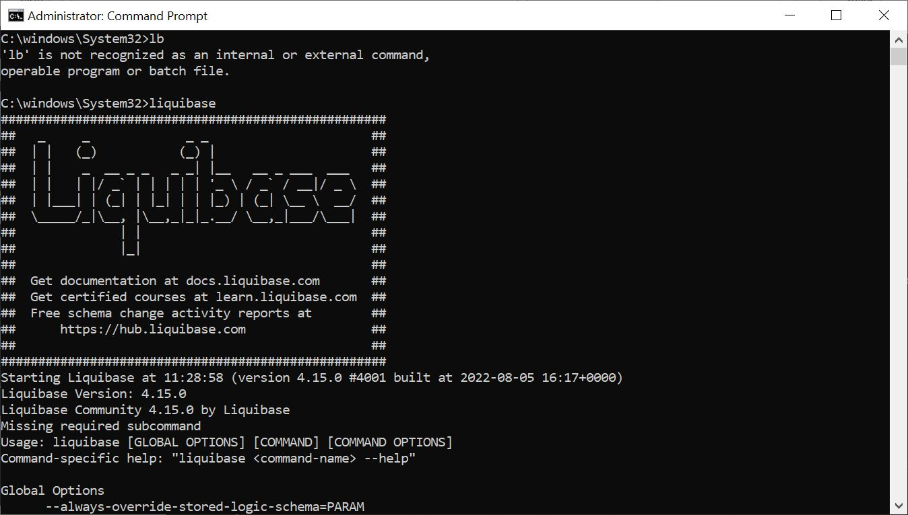
LiquiBase
Liquibase is an open source solution for managing revisions of your databse schema scripts. It works across various types of databases, and supports various file formats for defining the DB structure

Slide 27
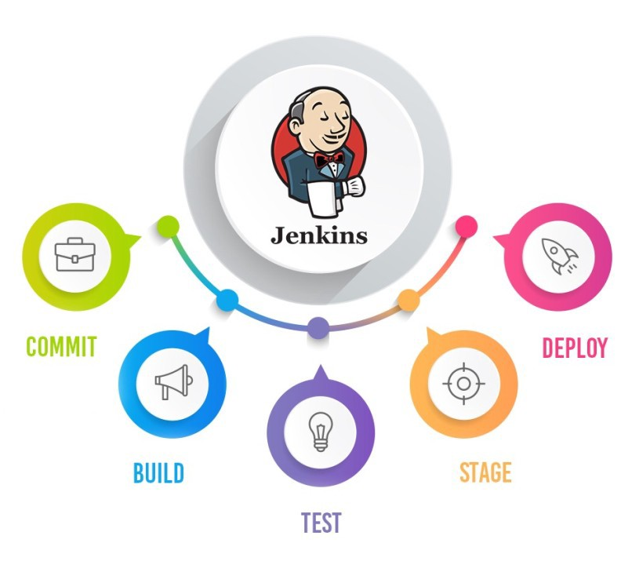
Testing and Deployment Through Jenkins

Slide 28
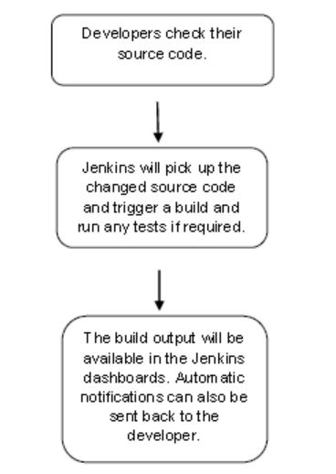
Jenkins
Jenkins is a software that allows continuous integration. Jenkins will be installed on a server where the central build will take place. The following flowchart demonstrates a very simple workflow of how Jenkins works.

Slide 29
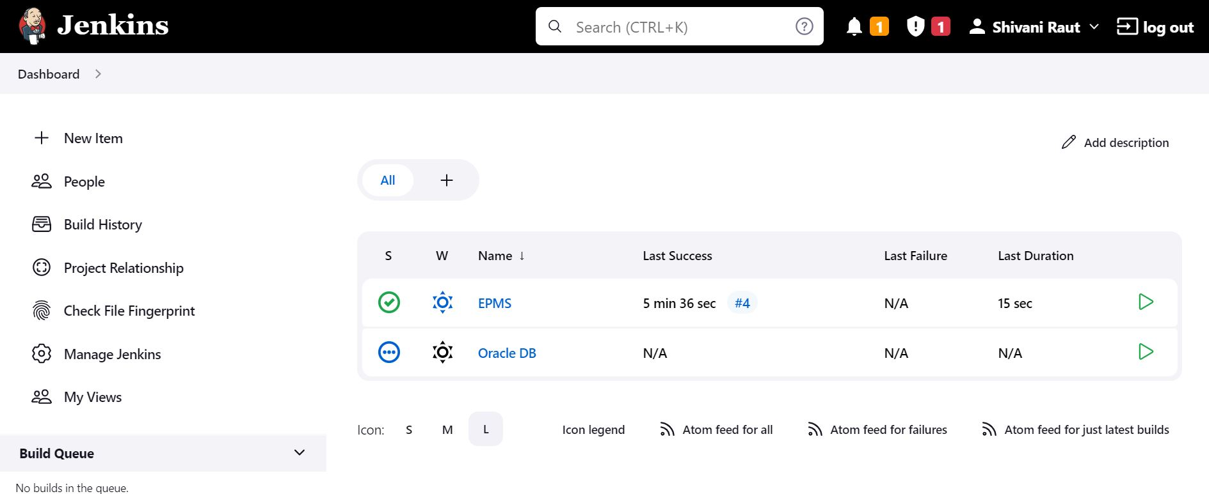
Jenkins Dashboard

Slide 30
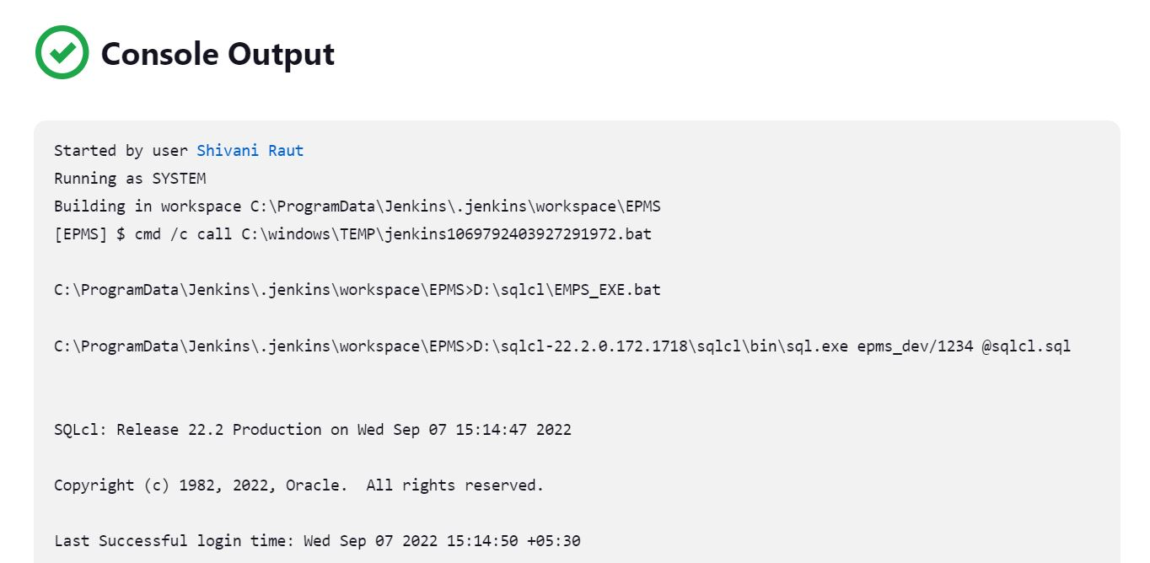
Jenkins Build Output

Slide 31
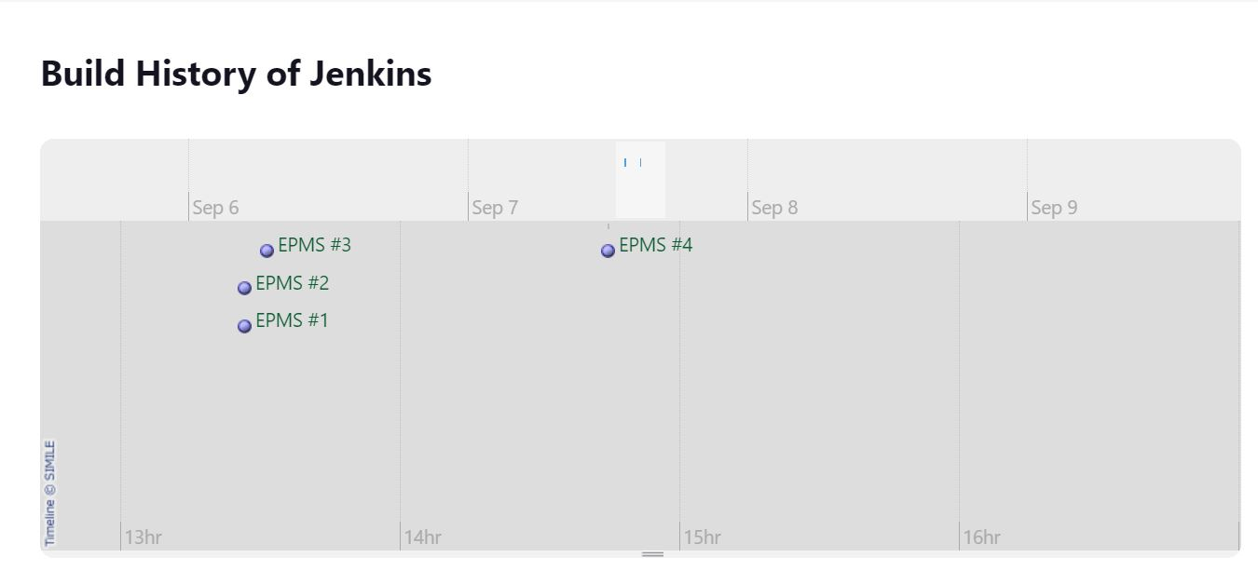
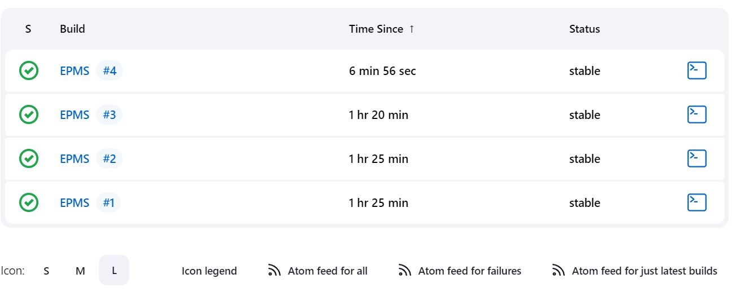
Jenkins Build History

Slide 32
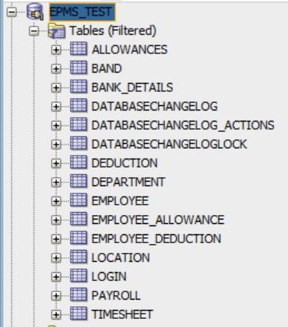
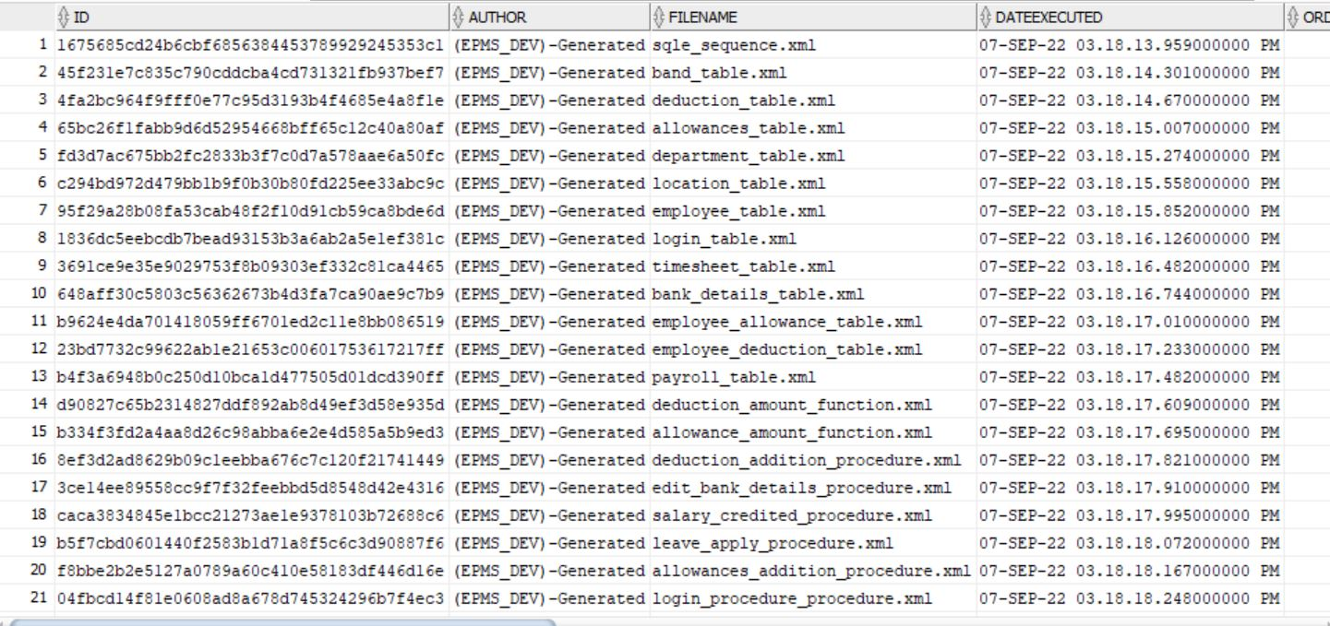
Testing Environment

Slide 33
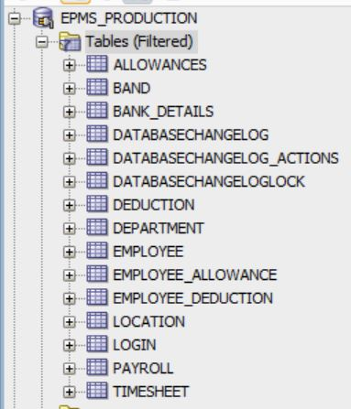
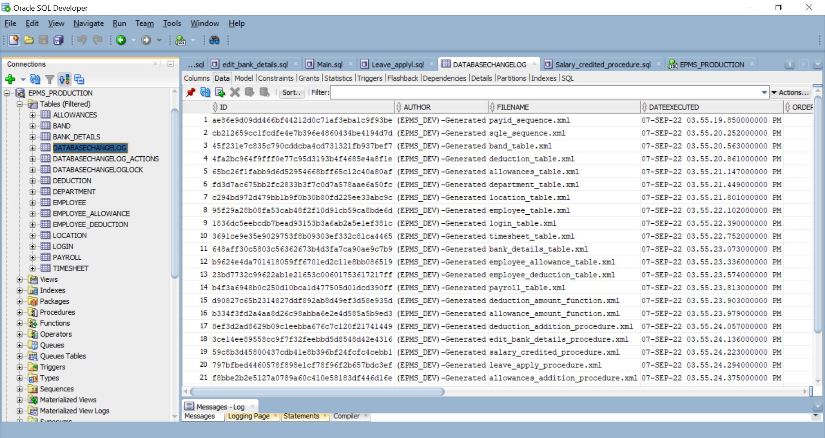
Deployment Environment

Slide 34
Choosing a Payroll System
It becomes difficult to find out the payroll system specially require. The criteria that help one to do so are as follows:-
Security
Comaptibilty
Credibility
Flexibility

Slide 35
References
https://www.oracle.com/database/sqldeveloper/
https://www.oracle.com/in/database/sqldeveloper/technologies/sql-data-modeler/
https://www.oracle.com/in/database/sqldeveloper/technologies/sqlcl/#:~:text=Oracle%20SQL%20Developer%20Command%20Line,execute%20SQL%20and%20PL%2FSQL.
https://www.liquibase.org/
https://www.java4coding.com/contents/liquibase/liquibase-tutorial#:~:text=Liquibase%20is%20a%20data%20base,%2C%20update%2C%20and%20delete%20operations.

